Slide 1
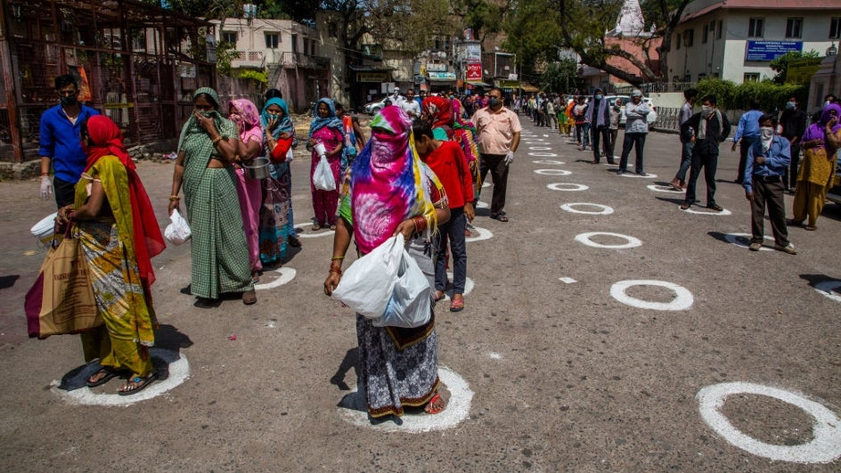
Epidemiology leading to Public Health Actions in India to fight COVID-19
Populous India is Social Distancing ...
weather.com
Dr. Omesh Kumar Bharti,
State Epidemiologist. Shimla, Himachal Pradesh

Slide 2
Epidemiology leading to public health action
When we don't have a cure or vaccine for novel coronavirus, epidemiological methods are driving decision making for public health in India.
Epidemiology of Coronavirus disease (COVID-19) is fast transmission, droplet infection, respiratory involvement leading to remission and few deaths.
This needs public health action at the level of breaking transmission by social distancing, preventing infection by cough etiquettes and masks, creating bed capacity and equipping hospitals to specifically treat COVID-19 patients by making PPEs, supportive drugs and machines like ventilators.

Slide 3
Epidemiology leading to public health action
Government of India is having expert advice of research bodies like ICMR and Head of epidemiology divisions of ICMR and NIE, Chennai.
Daily data analysis of COVID-19 cases guides the day to day strategies India adopts to contain the infection.
Prime minister of India is leading the campaign and declared countrywide lockdown on March 24 to prevent the spread of the novel coronavirus to help in slowing transmission and "flattening" the COVID-19 curve.
Today we have 10,477 active cases, 1488 cured and 414 deaths. With lockdown extended to May 3, 2020 we have 170 Hot Spots, 207 “potential” Hot Spots and rest 359 districts as Green zone that are interchangeable depending on future course of infection.
The transmission of infection is being strictly monitored area wise, district wise and state wise in India.

Slide 4
Epidemiology leading to public health action
The major problem in a pandemic is myth busting.
National toll free helplines (1075) and state helplines (104/108 etc.) have been active 24X7 to answer people’s queries.
Major myths doing rounds are;
- Hand-dryers are effective in killing the virus
-Exposure to sun’s rays can help prevent Covid-19
-Houseflies spread the virus
-Eating garlic helps prevent infection
-Covid-19 infections cannot be transmitted in areas with hot and humid climates
-Covid-19 spreads by eating chicken

Slide 5
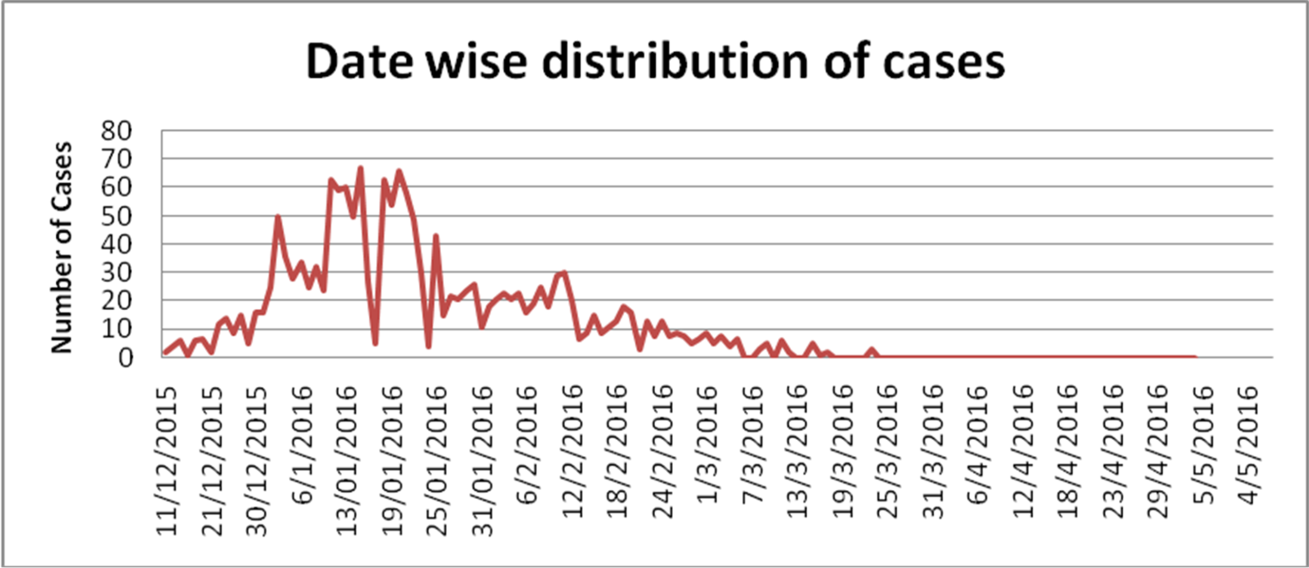
Epidemiology leading to public health action
With the help of epidemiological tools we were successful in predicting an impending Hepatitis outbreak in Shimla. Can we have this flattening for Covid-19, only time would answer.

Slide 6
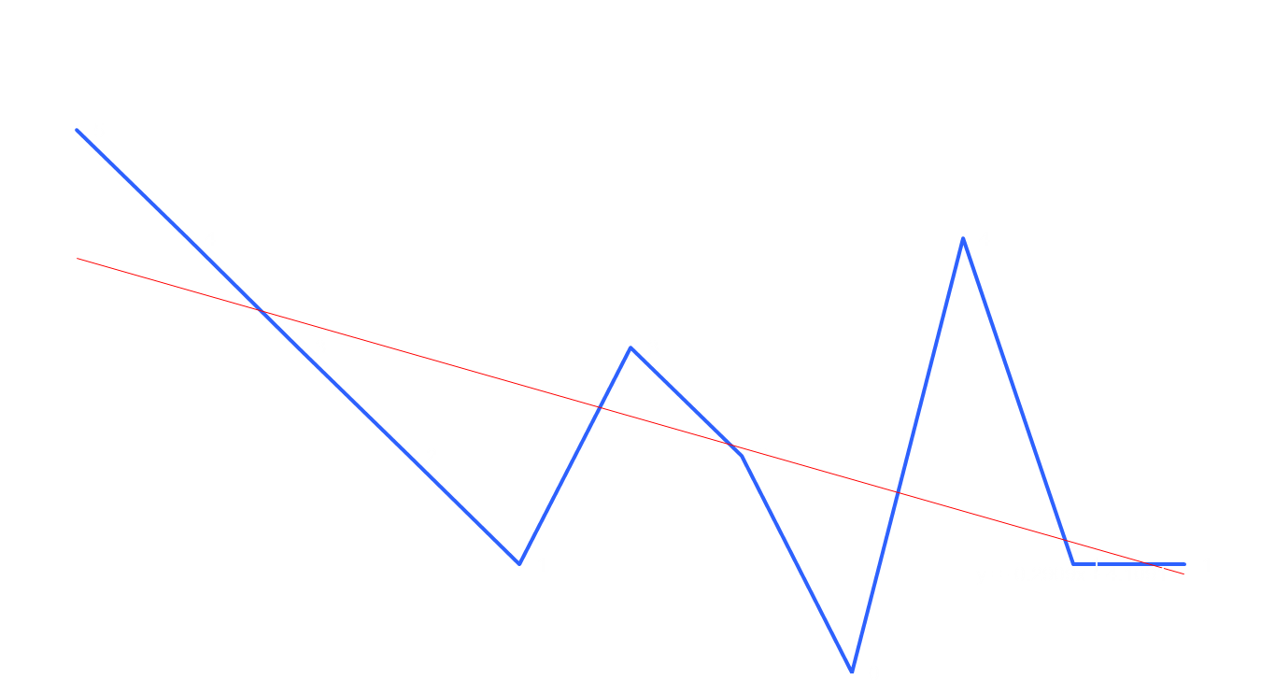
Epidemiology leading to public health action
By using Epidemiological tools we reduced the dose of rabies biologicals making them affordable to the poor and bringing yearly rabies deaths in Himachal Pradesh from 35 to almost zero. Can we do that for Covid-19 ?
2009-2019

Slide 7
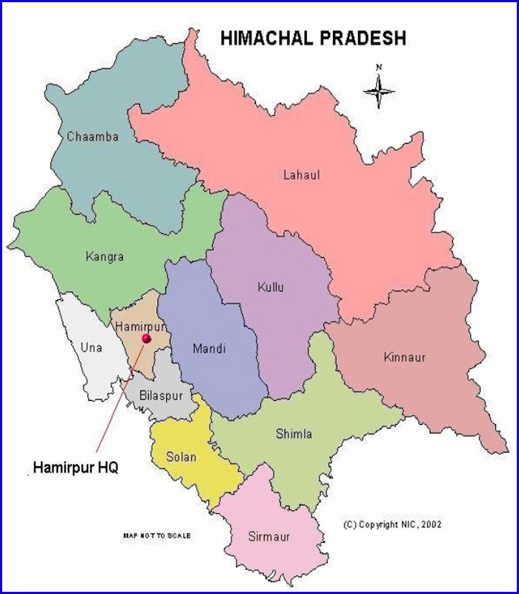
Epidemiology leading to public health action
In Himachal we have only 19 active Covid-19 cases out of 35 positive and only one death. 7/12 districts are free from Covid-19.

Slide 8
Thank You
There is a ray of Hope to win Covid-19 war !

