Slide 2
Making Snakebite an agenda of HP Health Department- Journey so far- Organised by; Annual Conference of the Indian Society for Toxinology and Snakebite Mitigation (ISTSM)
Dr. Omesh Kumar Bharti*
*State Epidemiologist; State Institute Of Health & Family Welfare. Parimahal, Shimla

Slide 3
How to make Snakebite an agenda of Health Department ? Barriers
No funds
No Snakebite treatment guidelines
No trainings to Doctors or paramedics
No lectures in Doctors’ Induction classes before service
No data on snakebite death & Disability
No Knowledge of snakes of Himachal Pradesh
No ASV at PHC level
No studies on Snakebite or Snakes of Himachal Pradesh
No collaboration with forest department

Slide 4
Secondary Data Analysis of Snakebite in Solan District
The author was assigned a PG doctor for local mentorship by NIE Chennai for Master’s in Epidemiology Course (MAE)
The author persuaded the docotor to do secondary data analysis of Snakebite in his native District, Solan
It was first of its kind secondary data analysis in Himachal
Colour of snake was recorded in 159 (32%) of snakes out of which 122 (77%) snakes were green
Whilst a national protocol for management of snakebites in India is also in place, some states have developed their own protocols. These protocols are not followed strictly which may lead to inappropriate management and irrational use of anti snake venom( ASV)

Slide 5
Secondary Data Analysis of Snakebite in Solan District
The National protocol recommends 10 vials of ASV as the initial dose in both haemotoxic and neurotoxic bites. For haemotoxic bites 5–10 vials of ASV are recommended as repeat doses at 6 hourly intervals till the restoration of the coagulation profile. For neurotoxic bites a repeat dose of 10 vials is recommended. At the Zonal Hospital, Solan, the treating physicians started giving 2 vials of ASV in haemotoxic bite as initial dose. The repeat doses were also given in multiples of 2 vials. This practice led to a reduction in average number of vials used as initial and repeat doses per envenoming. The physicians became aware that a large number of cases (77%) in this region reported with bites from Green Pit Viper (Pandey D – personal communication).
Therefore, they stopped administering ASV to such cases. They also stopped admitting these cases and monitored them as outdoor patients for any derangement in coagulation profile. In spite of the reduction in the usage of ASV a cure rate of more than 70% was achieved all through the years.
This understanding helped me convince national Authorities to include “NO ASV for Green Pit Viper Bites in INDIA” in National Protocol on Snakebite Management 2017.

Slide 7
Thanks to :
-Ministry of Health & Family Welfare, GOI
-National Health Systems Resource Centre (NHSRC)
-National Health Mission (NHM)
-Snake Bite Interest Group
( WhatsApp Group)
NO ASV for Green Pit Viper Bites in INDIA

Slide 8
Venom of several Indian green pit vipers: Comparison of biochemical activities and cross-reactivity with antivenoms- Toxicon 2021

Slide 9
ASV in 108 Ambulance Service in Himachal Pradesh, India
In February 2008, Secretary health called a meeting of doctors at Directorate of Health and asked if anyone volunteers to plan and run 108 ambulance project as about 6 crore (60 Million INR) is lapsing every year.
I was also called to meeting as special invitee
All senior doctors refused while I volunteered in the interest of helping poor rural patients
I was given the responsibility though I had less than 15 years of service while those having service 28-30 years refused to work for this prestigious project fearing likely (Imaginary)untoward consequences.

Slide 10
ASV in 108 Ambulances in Himachal Pradesh, India
Foe 2 years I worked hard to make a project for 108, how it would run and sustain etc.
It was decided to launch the 108 toll free ambulance service from Dec 25, 2010
I refused to allow the ambulances to run until they keep Anti Snake Venom in them and trainings are given to Paramedics how to administer ASV
I was persuaded to not to make an issue of ASV and let 108 run asap, I did not budge and forced them to keep ASV in 108 as snakebite is an acute emergency in rural areas.

Slide 11
ASV in 108 Ambulances in Himachal Pradesh, India
During First year, a total of 469 patients of snake bite cases availed the free emergency ambulance service i.e. from 25 December 2010 to 30th November 2011 by dialing toll free number 108.
Simple protocol followed was administration of ASV, inj Tramadol and Oxygen
Out of 469 cases in 47 cases (10.02%) ASV had to be used inside the ambulance in critical condition
Only one patient had mild allergic reaction and life saved after ASV utilization was 42 (89.36%). Total life saved out of 469 cases was 451 cases i.e. 96.2% of snakebite victims as followed up to 48 hours.

Slide 12
Snakebite management through free emergency ambulance service in Himachal saves lives

Slide 13
ASV now to be in all 108 ambulances
While in Hyderabad for some personal work I took some time off and met bosses of GVK-EMRI and praised their initiative in Himachal to keep ASV in Ambulances and appraised them how it was saving lives
After due discussions it was decided to keep ASV in all 108 ambulances (more than 1000) run by GVK-EMRI in more than 16 states across India
After sometime a paper was published describing how ASV in ambulance saved lives of thousands of snakebite victims across different states of India
May be the first initiative of its kind in the World

Slide 14
Transporting Snake Bite Victims to Appropriate Health Facility within Golden Hour through Toll Free Emergency Ambulance Service in India, Save Lives

Slide 15
Collaboration with Bongor University, UK for snakebite mapping and venom analysis in Himachal Pradesh since 2017
A collaboration agreement was done with Bongor University, UK for collaboration on snake identification, venom and genetic analysis of snakes found in Himachal Pradesh
I agreed to get required permissions from Forest department
For the first time a database of Snakes of Himachal was made available to the forest department
A detailed presentation was given about venomous and non-venomous snakes of Himachal Pradesh
New species like Naja Oxiana etc. were identified

Slide 16
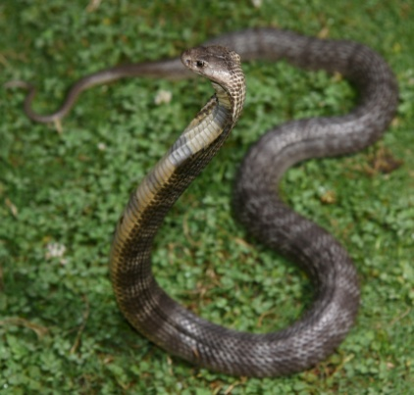
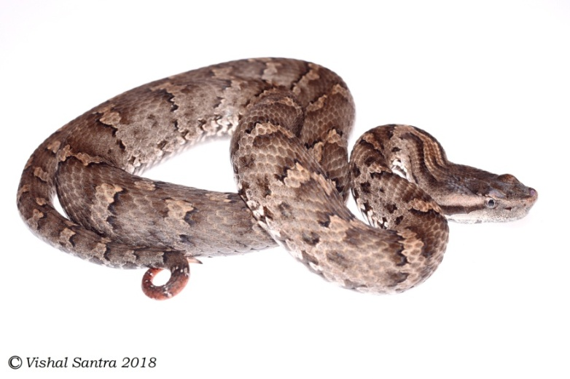
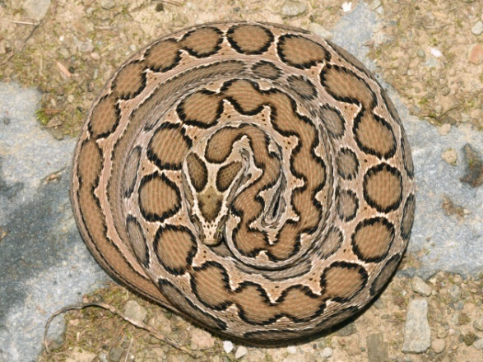
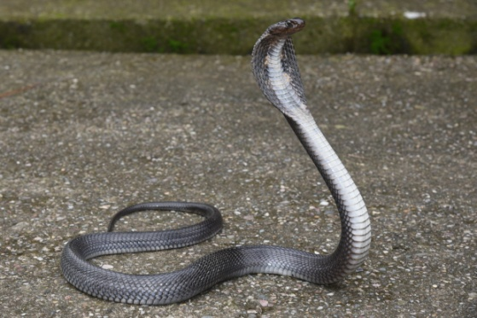
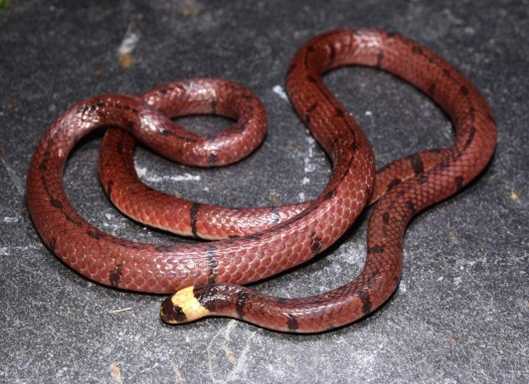
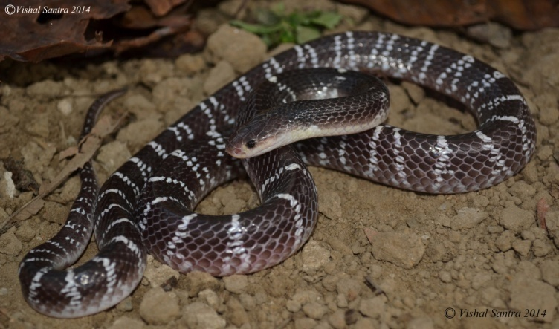
"Medically Significant Species of Himachal Pradesh“-Pics by Vishal Santra
Russell’s viper (Daboia russelii)
Himalayan pitviper (Gloydius himalayanus)
Central Asian cobra (Naja oxiana)
Photo: Vishal Santra
Black cobra (Naja naja)
Coral Snake from Kullu
(Pic by Vishal Santra)
Common krait (Bungarus caeruleus)
Western green pitviper (Cryptelytrops septentrionalis)
Notes:
The ones outlines in red belong to the “big Four” which are included in antivenom preparation. However, clinicians record many deaths from the “black” cobra (melanistic version of spectacled cobra) and severe coagulation disruption from bites from the green pit viper.

Slide 17
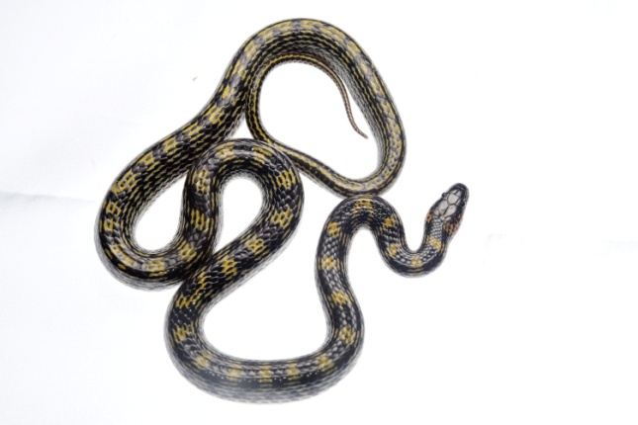
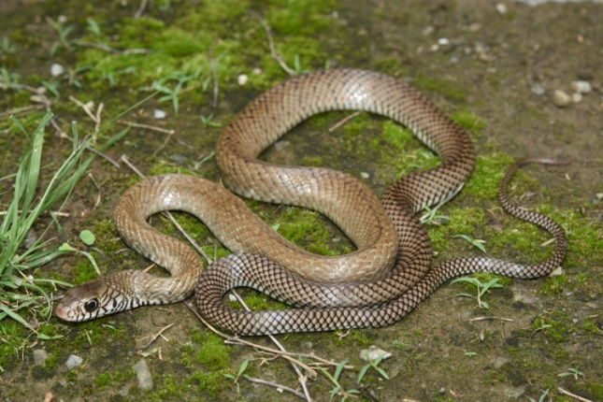
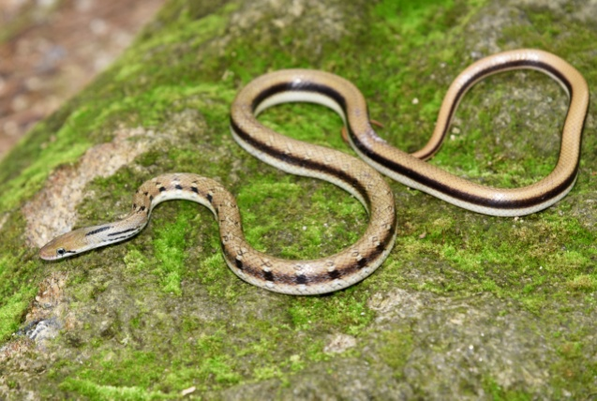
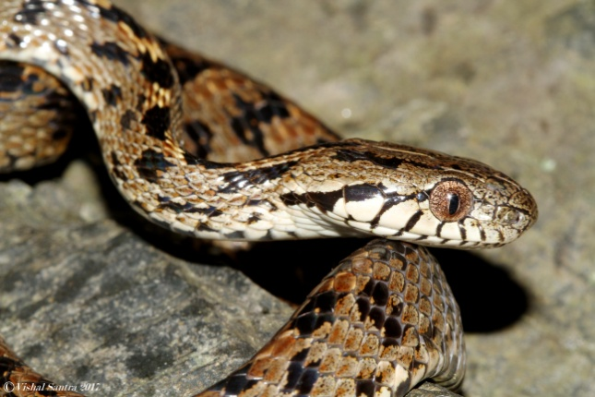
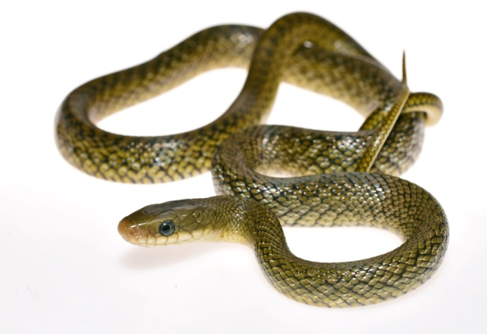
Common non-venomous snakes species of HP-Pics by Vishal Santra
MacKinnons’s wolf snake (Lycodon mackinnoni)
Indian rat snake (Ptyas mucosa)
Common Trinket Snake
Coelognathus helena
Common cat snake (Boiga trigonata)
Many-banded cat snake (Boiga multifasciata)
Himalayan trinket (Elaphe hodgsoni)
Photos: Vishal Santra
Notes:
.

Slide 18
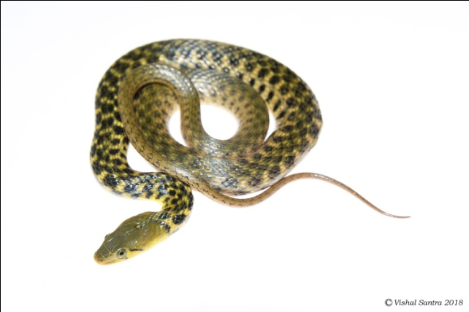
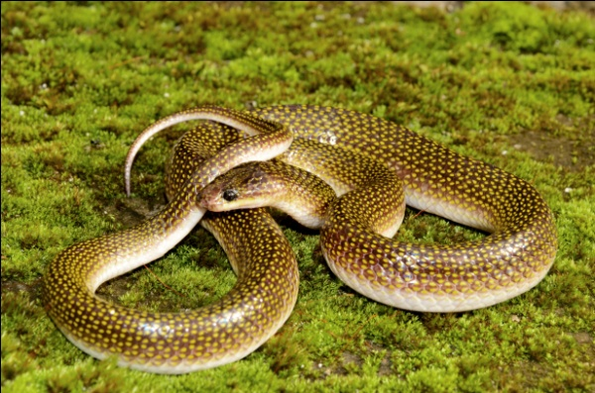
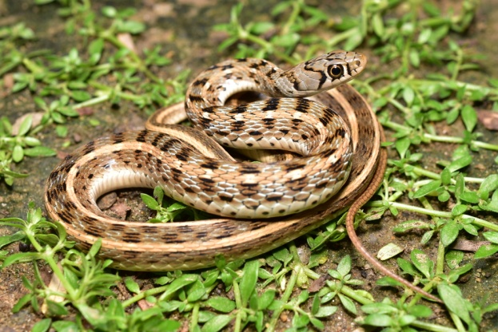
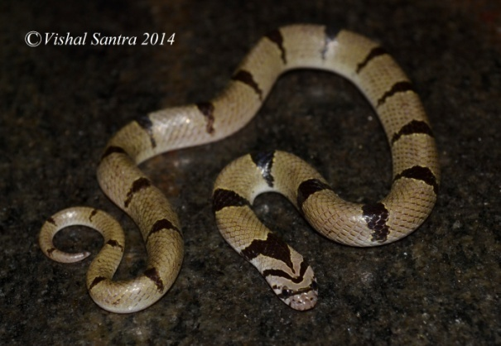
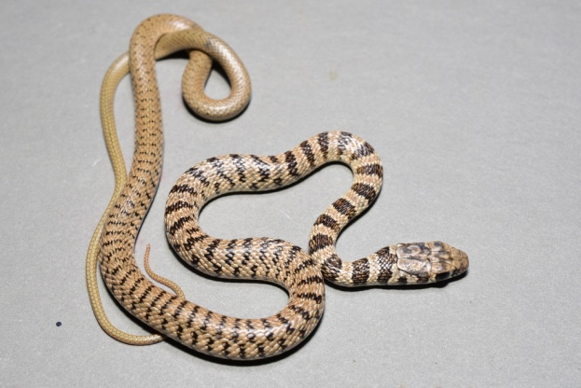
Common Non-venomous Snakes of Himachal Pradesh- Pics by Vishal Santra
Common wolf snake
Lycodon aulicus
Checkered keelback water snake
Fowlea piscator
Yellow speckled wolf snake
Lycodon jara
Buff stripped keelback
Amphiesma stolatum
Common kukri snake
Oligodon arnensis
Common cliff racer
Platyceps rhodorachis

Slide 19
Species Checklist In Himachal Pradesh by Vishal Santra
Sl. No. | Snakes | Lizards | Amphibians
1. | Bungarus caeruleus | Eurylepis taeniolatus | Amolops cf. formosus
2. | Trimeresurus septentrionalis | Cyrtodactylus lawderanus | Euphlyctis sp
3. | Lycodon aulicus | Cyrtodactylus chamba | Duttaphrynus himalayanus
4. | Daboia russelii | Laudakia tuberculata | Duttaphrynus melananostictus
5. | Ptyas mucosa | Asymblepharus ladacensis | Duttaphrynus stomaticus
6. | Amphiesma stolatum | Calotes versicolor | Microhyla ornata
7. | Coelognathus helena (DOR) | Hemidactylus cf. brookii | Spaerotheca sp
8. | Argyrophis diardii | Hemidactylus flaviviridis | Hoplobatrachus tigrinus
9. | Boiga trigonata | Ophisops sp
10. | Boiga multifasciata | Varanus bengalensis
11. | Gloydius himalayanus
12. | Naja oxiana
13. | Orthriophis hodgsoni
14. | Lycodon mackinnoni
15. | Oligodon arnensis
16. | Oligodon sp
17. | Fowlea piscator
18. | Liopeltis rappi
19. | Naja naja

Slide 20
Data on Snakebite in Himachal Pradesh
No data on snakebite was available in Himachal Pradesh
I met Secretary Health, Director Health Service and Mission Director (MD) National Health Mission (NHM)and emphasised the need for data collection on snakebite though it is there in Integrated Disease Surveillance Project (IDSP) as mandate
MD NHM was also appraised lack of training of doctors on snakebite management and need to do that.
I met Secretary Disaster Management Department (DM) and stressed the need to mitigate snakebite disaster by awareness.
DM Department started an advertisement on FM radio
Same Advertisement was followed by NHM later
For the First time ever, snakebite was in government advertisements and minds of decision makers

Slide 21
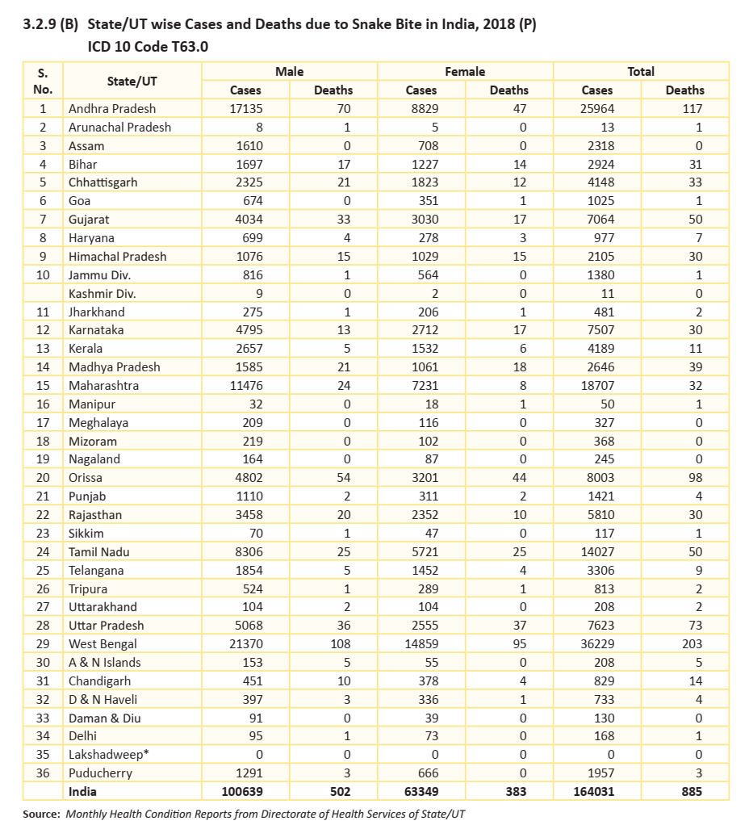
There is huge difference between reporting of snakebite and actual deaths in India

Slide 22
District wise Yearly Snake Bite Cases in H.P.(IDSP)
S.NO | DISTRICT | 2015 | 2016 | 2017 | 2018 | 2019
1 | BILASPUR | 115 | 118 | 91 | 42 | 15
2 | CHAMBA | 55 | 17 | 56 | 55 | 18
3 | HAMIRPUR | 160 | 182 | 97 | 54 | 3
4 | KANGRA | 124 | 126 | 245 | 141 | 5
5 | KINNAUR | 4 | 0 | 0 | 1 | 0
6 | KULLU | 48 | 37 | 62 | 20 | 10
7 | L & SPITI | 1 | 0 | 0 | 0 | 0
8 | MANDI | 104 | 171 | 177 | 45 | 3
9 | SHIMLA | 22 | 38 | 6 | 21 | 30
10 | SOLAN | 229 | 234 | 191 | 151 | 14
11 | SIRMAUR | 41 | 16 | 10 | 13 | 74
12 | UNA | 2 | 89 | 401 | 32 | 12
State |  | 905 | 1028 | 1336 | 575 | 184

Slide 23
Economic losses in India; Courtesy Dr. Denny John
5 studies identified with economic data (1 cost-effectiveness, 3 healthcare expenditure, and 1 compensation study)
Studies used different methods such as resource utilization, patient questionnaires and expenditure analysis
Average cost ranged from 0 (16.3%)- US$ 4345 (8.1%)
Cost of US$ 4345 includes total cost (treatment, amputation, AV and adjunct)
40% of victims required loan (sale of crops/land, valuables, cattle, bicycles/motorcycles) or reducing expenditure (e.g. pulling children out of school)
Maximum amount of USD 4345 equals to 12 years income of agriculture worker in India

Slide 24
Snakebite awareness material for Doctors and Paramedics of Himachal Pradesh

Slide 26
Later after Lot of Persuasion Forest department agreed to publish awareness booklet drafted by us in vernacular HINDI for general awareness-(1000 copies)

Slide 27
Collaboration with Wild Life Wing of Forest Department for trainings to front line staff on Snake rescue and Release

Slide 28
Collaboration with Wild Life Wing of Forest Department for trainings to front line staff on Snake rescue and Release

Slide 29
Collaboration with Wild Life Wing of Forest Department for trainings to front line staff on Snake rescue and Release

Slide 30
Distribution of Awareness posters and leaflets among school children

Slide 31
How we started Trainings of Doctors and Paramedics in Himachal Pradesh
There are no funds for snakebite trainings as there is no National snakebite mitigation programme
I used to be called to training institute for trainings on various National Programmes like RNTCP, Leprosy etc
I used to save time an give additional lectures on snakebite and its management
The training feedback by Doctors and paramedics used to appreciate these lectures and demand was there to include snakebite training as full lecture
That’s how snakebite training is now full lecture especially for doctors before they join service called “ Induction Training”

Slide 32
PIL in high court (2015-16)
Looking at the reports of non availability of ASV in hospitals some activists filed a PIL in high court regarding non availability of ASV and Anti Rabies Vaccine (ARV) in rural areas and PHCs
High court directed the Himachal Government to ensure availability of ASV & ARV in all hospitals including Primary Health Centres (PHCs)
I ensured that ordinary fridges are purchased and installed in all PHCs in Shimla district and ASV & ARV is available up to PHC level, other districts also complied.

Slide 33
Nationwide study on snakebite death, disability and economic loss
In collaboration with Dr. Jaideep Menoen we successfully got ICMR study on Nationwide snake bite death, disability and economic loss sanctioned
It would be first of its kind estimation of death and disability due to snakebite in India
With government involvement we got additional district Una added to already sanctioned districts of Kangra and Chamba
Almost Half of Himachal would be covered.

Slide 34
Pilot testing of Topical antibiotic spray on snakebite wound
With a joint co-operation of Deparment of Biotechnology HP University, NGO working in herbal production we developed an antibiotic herbal extract for pilot testing as spray and successfully pilot tested it on 15 patients 11 of whom were bitten by Russell's Viper.
Non of the patients developed blisters except mild blisters in 2 patients that healed spontaneously.
We got 9 lakh as grant from JICA to further this experiment on more patients this year.

Slide 36
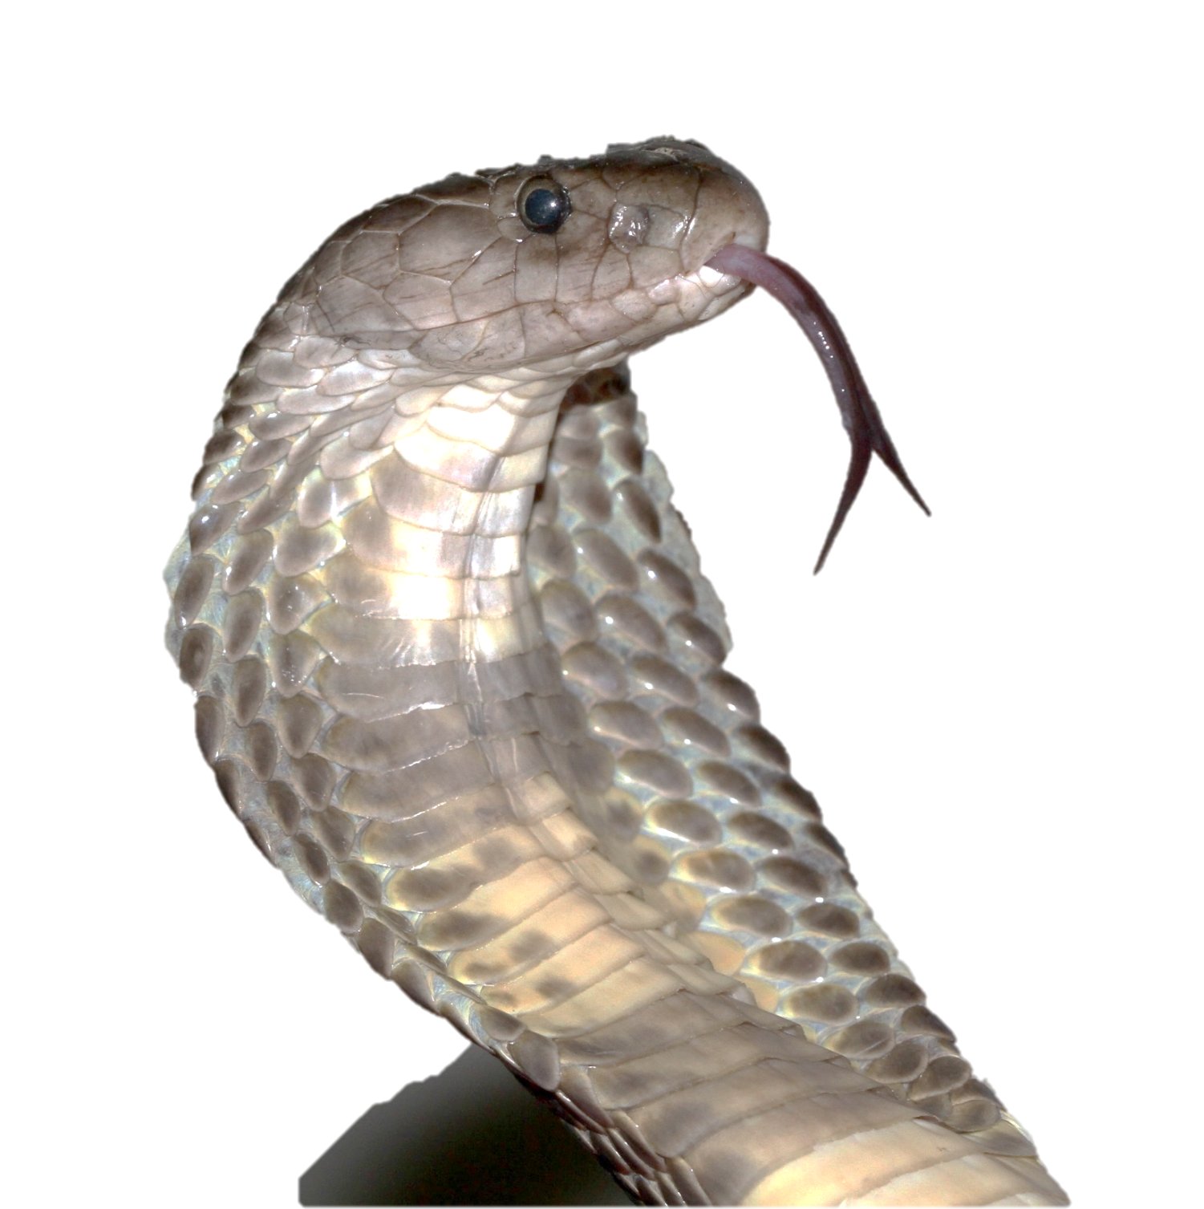
Thanks to our team…
Anita Malhotra¹, Wolfgang Wüster¹, Archana Deka², Robin Doley², Vishal Santra³, Benjamin Owens⁴,
Omesh Kumar Bharti⁵
1 School of Natural Sciences, Bangor University, UK
2 Dept of Molecular Biology and Biotechnology, Tezpur University, Assam
3 Simultala Conservationists, Hooghly, West Bengal
4 Captive and Field Herpetology, Anglesey, UK
5 State Institute of Health and Family Welfare, Shimla, Himachal Pradesh
Photo by Vishal Santra

Slide 37
For any clarification please contact
bhartiomesh@yahoo.com
Mobile:
094181-20302
Address:
Set-9, Block-1, US Club Shimla, Himachal Pradesh, India-171001

Slide 38
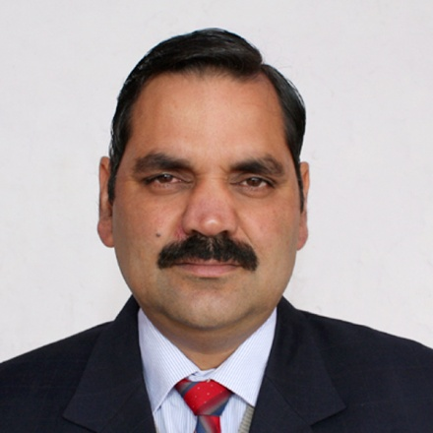
CV_ Omesh Bharti
Dr. Omesh Kumar Bharti, MBBS, DHM,MAE(Epidemiology)
State Epidemiologist, Parimahal, Shimla, HP, India
Received more than 10 Honours/Awards including “ Padma Shri”
Published more than 45 papers in National/International Journals
Reviewer for esteemed journals like Vaccine, Human Vaccine and Immunotherapeutics, WHO Bulletin, PLOS One etc.
Selected International Conference Judge at Korea
Cited extensibly by WHO publications
Hobbies include singing, poetry, playing musical instruments, Photography & Music
Working on Rabies, Snakebite, Thalassemia, Bovine Tuberculosis & Outbreak investigations.
Mobile: 094181-20302 Emai; bhartiomesh@yahoo.com
Address: Set-9, Block-1, US Club Shimla, Himachal Pradesh, India-171001

