Slide 1
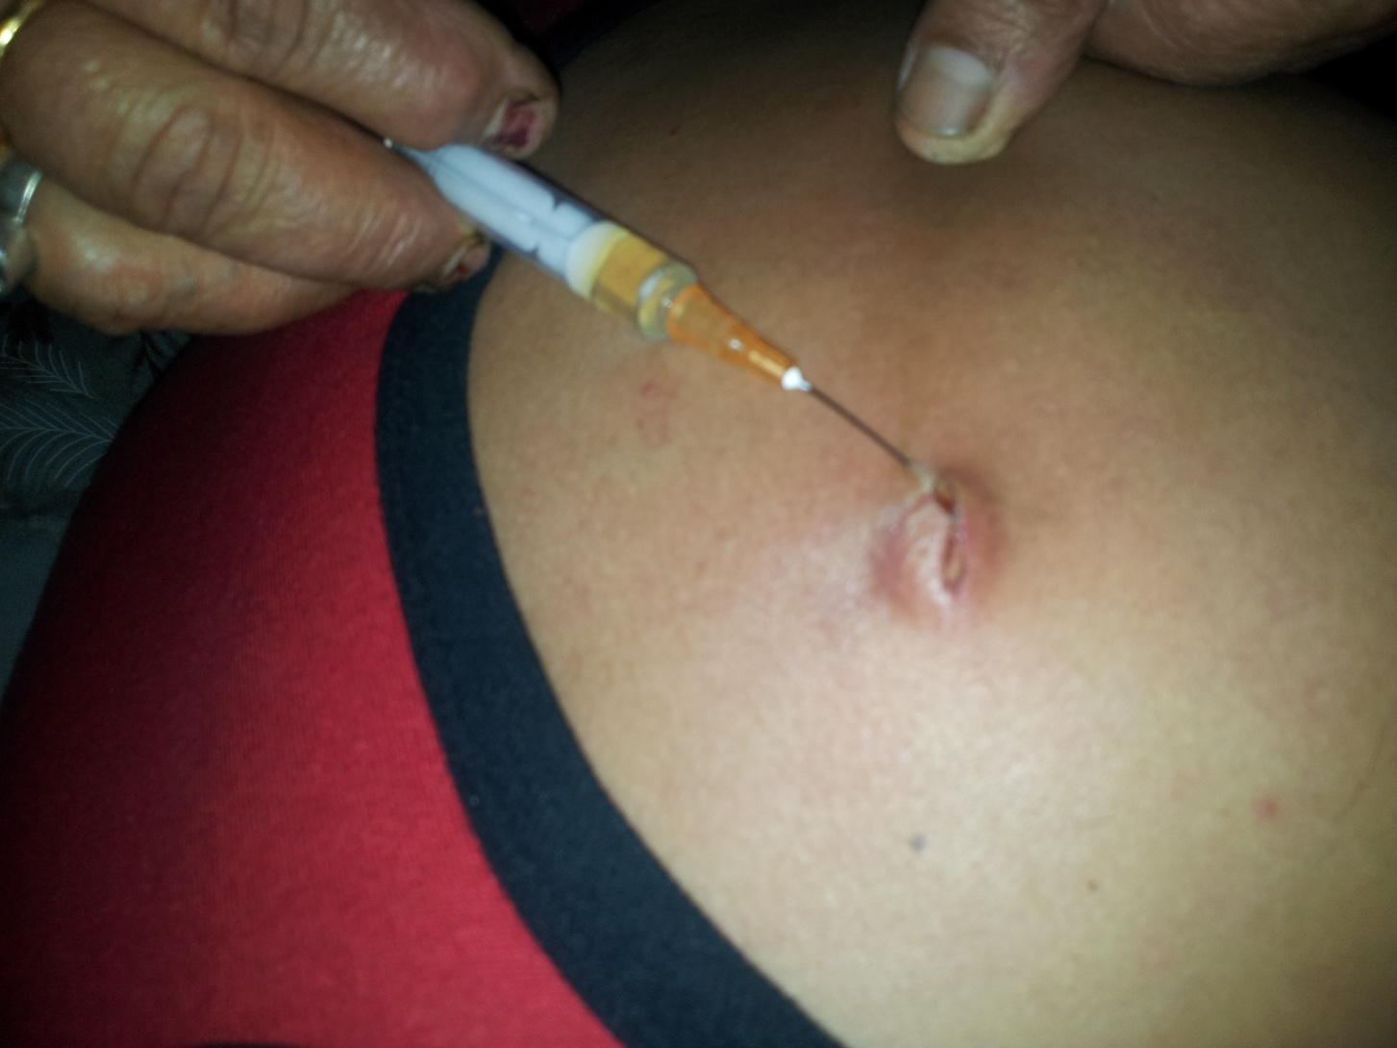
Local infiltration of Rabies immunoglobulins without systemic IM administration: An alternative cost effective, life saving and affordable approach for passive immunization Against Rabies
Omesh.K.Bharti, S.N.Madhusudana, P.L.Gaunta, Ashwin B.Y.

Slide 2
Background
Globally:
An estimated 55,000 persons die of rabies every year.
31,000 deaths are reported from the Asian continent.
In India*:
40 % of global rabies deaths ( 20,000 deaths)
The frequency of human rabies deaths:
1 case every 30 minutes
Animal bite incidence rate: 17.4 per 1000 population
17.4 million bites every year.
Annual man-days lost due to animal bite : 38 million.
Annual medicinal (vaccines + other drugs) cost for animal bite treatment: $ 4 Million (2003)
* WHO-APCRI study - Assessing burden of Rabies in India

Slide 3
RIGs not affordable / not available
The main reason for high death rate in India is lack of awareness regarding first aid, vaccination and rabies immunoglobulins (RIGs) and high cost of treatment of animal bite cases.
We observed in our clinic that many of the bite victims are not purchasing rabies immunoglobulins (RIGs) for want of high costs involved.
Literature was reviewed extensively to arrive at a method in such circumstances to find out low cost effective solutions.

Slide 4
When RIGs are unaffordable ! A case study
A women, 38 years old died of rabies due to dog bite, suspected to be rabid in the year 2009 in Theog bock of Shimla district.
The lady belonged to rich family and could have afforded any costs for the treatment.
She had taken post exposure prophylactic anti-rabies vaccine the very next day of bite up till full course but the doctor did not prescribe her RIGs as this was not available either in the hospital or outside chemist shops in Theog.

Slide 5
When RIGs are not affordable ! A case study
While the serum was not available in the hospital the outside shops did not keep RIGs due to non purchase of RIGs by majority patients due to its high costs and this resulting in the expiry of the available serum causing losses to the chemists
So, if there is no widespread use of a medicine, then chemists tend to not to store it and it can be unavailable for even those who can afford it.
Can we give the RIGs into local wounds only for those who can afford this much cost, making it affordable for them and minimize the damage?

Slide 6
When IM RIGs are not effective !
Dean and Baer had shown in a classic study in 1963 that intramuscular injection of antirabies serum will not provide a protective systemic level and that local injection of rabies virus-contaminated wounds is essential for survival in cases of severe exposure*.
It has become standard practice at the Queen Saovabha Memorial Institutes animal bite clinic in Thailand, to administer all of the calculated volume of ERIG or HRIG into and around wounds when necessary. One 11-year-old boy died of rabies in 1987 when a single puncture wound of the finger was not infiltrated with RIG; all of the 40-IU/kg dose had been given intramuscularly in the gluteal region**.
*Dean DJ, Baer GM, Thompson WR. Studies on the local treatment of rabies infected wounds. Bull WHO 1963;28:477-86.
**Wilde H, Sirikawin S, Sabcharoen A, Kingnate D, Tantawichien T, Harischandra PA, et al. Failure of postexposure treatment of rabies in children. Clin Infect Dis. 1996;22:228-32.

Slide 7
Local RIGs Study
Keeping in view the un-affordability of RIGs by the patients and their non availability in the market, a study was planned to know the impact of only local infiltration of RIGs where the rest of the calculated dose was not to be given in the muscle, based on the evidence in the literature and non availability of RIGs in market.

Slide 8
Local RIGs Study
Local RIGs study started from June 1, 2014 at ARCRC.
We could procure 25 vials of Anti-Rabies Serum (ARS) from CRI Kasauli and started giving ONLY Local infiltration into wound in Cat-III bites from June 1, 2014 at ARCRC.
Same batch of vaccine, Vaxirab-N batch CM-132 having a potency of 7.18 IU against the required 2.5 IU was used to compare the Antibodies. output .
Anti Rabies serum (ARS) from CRI Kasauli (Batch RS 1402 L-7) was used, and had high Abs titers of 550 IU/ml against the required 300 IU/ml.
The study period saw 456 patients i.e. 8 new patients on each working day of this period.( 57 working Days)
12 rabid dog/ cat bite pts, some referred from IG Medical College were followed for more than 9 months without failure.

Slide 9
Local RIGs Study
Out of 269 the animal breakup is as follows:
Monkeys -116,
Stray dogs -67,
Pet dogs -76,
Dogs -8,
Cats -4,
Rabid pup 2.5 M -1,
Suspected Rabid Dog -1,
Rabid Cow -1,
Pet Cat -1.
Pup -1,
Stray Pup -1,
Langoor -1,
Wild Pig -1,
The FAT/BT done at CRI Kasauli show that the biting animals in Shimla Town are not free from Rabies Virus.

Slide 10
Local RIGs Study
A total of 269 patients were included for local infiltration of RIGs into the wound without any IM administration
Against the 363 vials of RIGs required for all these cases as per WHO recommendation (13645 Kg), they required only 42 vials.( Min dose was 0.025ml and maxi. 8 ml)
Even those who could not afford the RIGs could have it.
Also when RIGs is not available in the market, those who could afford but could not get it in the market could also get it free in the ARCRC.
Till date no death has been reported as is the case elsewhere, where vaccine was given but not the RIGs.
A part from saving lives, a saving of more than 1.76 Lakh was achieved and also the RIGs could be made affordable to all.
A total of 30 samples were sent for RFFIT and all showed very high antibody titers ranged from 4.5 IU/ml- 30 IU/ml at D 14

Slide 11
Local RIGs Study- A win - win situation
In 2013 out of 1834 patients. Treated for animal bite only 4 purchased RIGs i.e. 8 vials but with local infiltration of RIGs, out of 456 patients for local RIGs study, 42 vials of RIGs were required. 21 times more RIGs vials were used.
On an average 1.26 ml of RIGs was required per patient.
At present companies producing rabies immunoglobulins are discouraged as either the doctors do not prescribe RIGs and if they prescribe then the patients do not purchase them for want of their high costs.
Local RIGs study would make RIGs affordable to patients as they may not have to spend more than a 150 Rupee and also this would help consume more vials that would give boost to their production by companies.

Slide 12
Local RIGs Study
In one year since this study started till 31st May 2015 we have seen 2097 patients and out of that 64 were bitten by suspected rabid animals and 7 were bitten by lab confirmed rabid dog but no deaths has been reported till date.
Practice still continues as no RIGs are available in the market.
Two suspected rabid dogs were impounded by the dog squad of MC Shimla in April as they were on biting spree in the town and one (Black) died of clinical rabies as reported by veterinary doctor and the other (Brown) was found to be confirmed rabid by FAT test at CRI Kasauli. Both have bitten 18 people in three days in Shimla city.
Follow up of all patients is continuing without any adverse report till date and all including those bitten on face and lip are healthy after more than 4 months.

Slide 13
Conclusion
Local infiltration of RIGs is highly efficacious and need to be considered in times of non availability in the market or un-affordability.
Local RIGs use would help companies think of production as 21 times more RIGs were utilized than the traditional method as they become affordable to more people now.
In Local RIGs study only two mild local reactions reported and given IM avil, rest were pain and swelling at injection site.

Slide 14
Local RIGs Study
Sr. No. | Animal | Age | FAT +/_ | BT +/- | remarks
1 | Pup | 2.5 M | +ve | Not done | The pup was found dead near Raj Bhawan Forest
2 | Dog | Adult | +ve | +ve | The dog was found dead at Sanjauli.
3 | Dog | Adult | +ve | +ve | The dog was found dead at Chaura Maidan.
4 | Monkey | Adult | -ve | +ve | The monkey was found dead at Mall Road Shimla.
5 | Langoor | Adult | +ve | +ve | The Langoor was found dead at Middle Bazaar.
6 | Himalayan Palm Civet | Adult | +ve | +ve | The Civet was found dead at Mall Road Shimla.

Slide 15
Suspected Rabid dog bite patients on face and lips

Slide 16
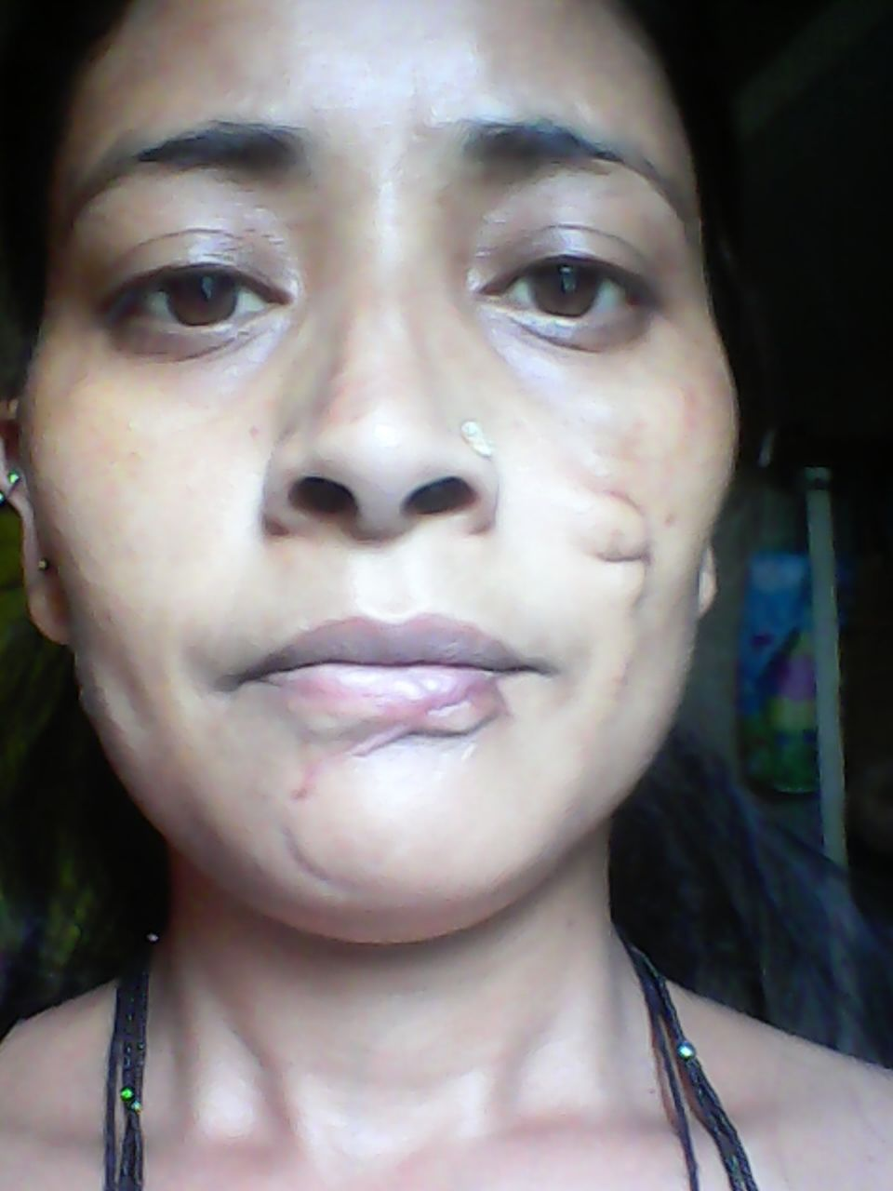
Suspected Rabid dog bite patients on face and lips. Patients after more than seven months of follow up of local RIGs

Slide 17
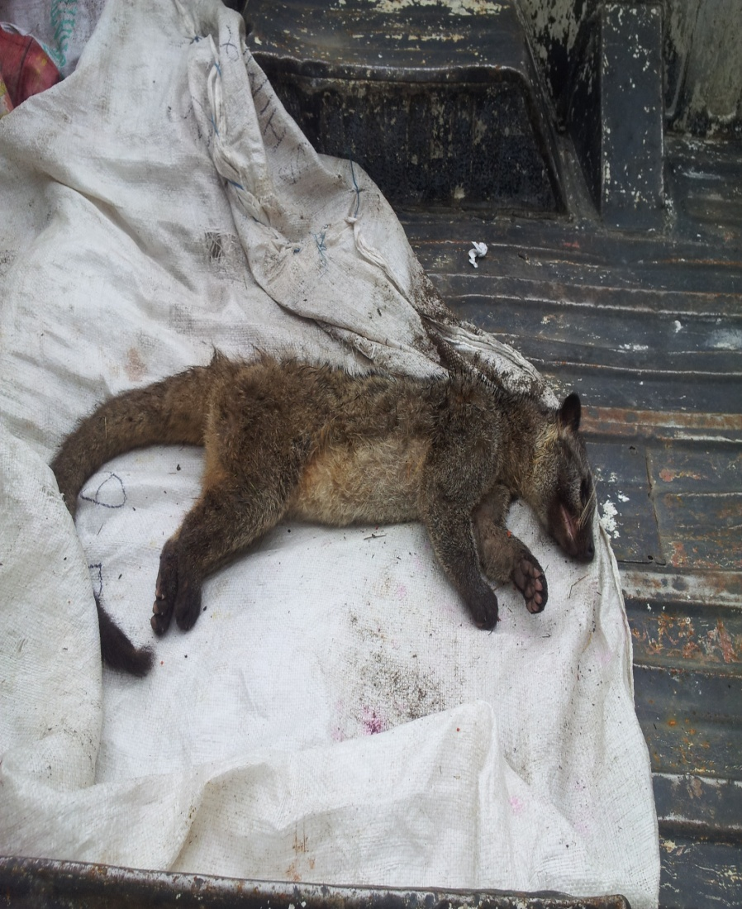
Brains of local wild animals reported freshly dead for FAT/BT at Kasauli

Slide 18
Local RIGs Study- Loose Stitching 3 days after Local Infiltration in the Gaping Wound

Slide 19
Local RIGs Study- Local Infiltration in scar after 2 months of rabid pup bite

Slide 20
Stitches on the lip without RIGs infiltration- A bad practice in animal bite cases

Slide 21
For any clarification please contact bhartiomesh@yahoo.com
Mobile:
094181-20302
Address:
Set-9, Block-1, US Club Shimla, Himachal Pradesh, India-171001

